Slide 1
Elevator controlling system
Object Oriented Analysis and Design course
Instructor: Armen Kostanyan
Prepared by : Nare Karapetyan Astghik Mkrtchyan

Slide 2
Outline
Domain Model
Text Use Cases and System Sequence Diagrams
Design Class Diagram

Slide 3
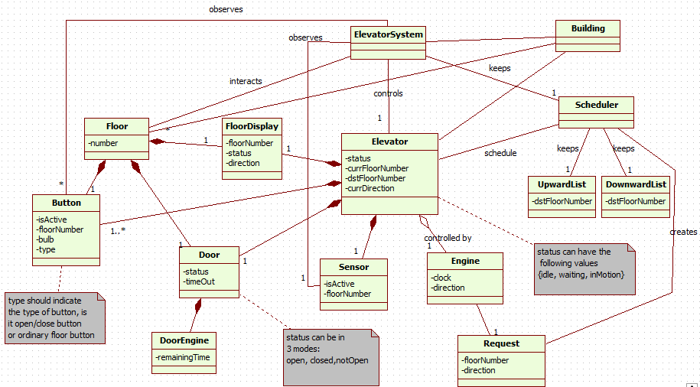
Domain Model

Slide 4
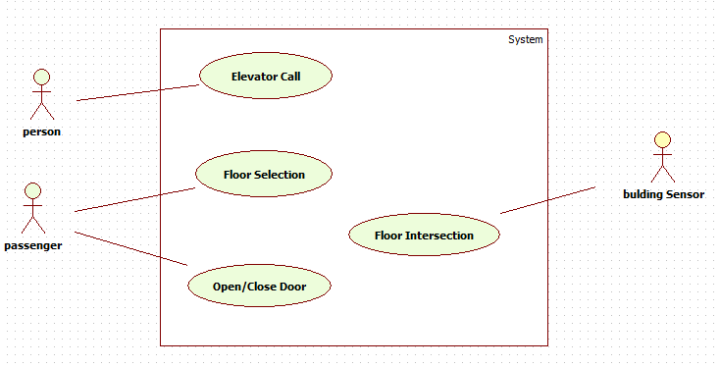
Use Case Diagram
Primary actors:
Persons Passengers Building(sensors)
Interests:
Users(Persons and Passengers) want to reach requested floor fast after waiting minimal time.

Slide 5
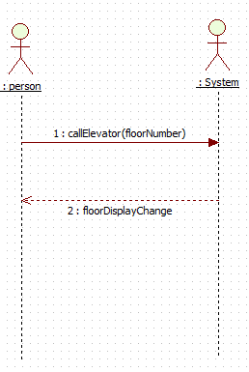
UC1: Call an elevator
1. Person approaches an elevator and requests a direction by pressing corresponding floor button.
2. The button sends a signal to Elevator Controller. scheduler arranges new request according to its type adding to the Upwards or Downward lists.
3. Scheduler according to the Elevator’s current direction rearranges jobs, selects the nearest job.
4. If Elevator is idle put in movement elevator. Otherwise continue path.
5. Elevator in motion is displaying his current destination and direction. The currFloorNumber changes continually during motion. And Elevator status sets to waiting.
6. Elevator reaches the requested floor.
7. Engine Stops at the destination.
8. Floor Display shows Elevator’s current destination and direction.
9. Elevator and floor doors are opened. Person becomes passenger entering to the cabin

Slide 6
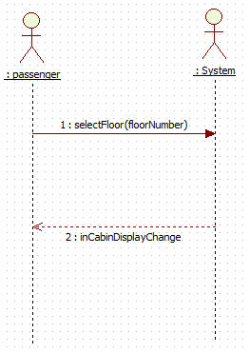
UC2: Floor Selection
1. Passenger selects the floor number.
2. Controller notified about floor selection, decide the job direction based on Elevator’s current direction and pass job to Scheduler.
3. Job added to corresponding List. Scheduler updates Elevator’s job if necessary,
4. Elevator will perform selected job, meaning that it will arrive to the corresponding floor.
5. Floor and elevator doors are opened.
In cabin Display shows continually the elevator’s destination and direction of the motion.
6. Scheduler updates Elevator job.

Slide 7
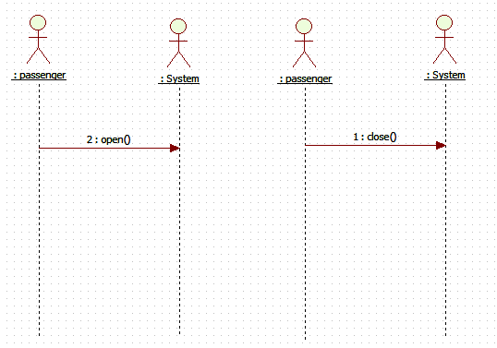
UC3: Open/Close doors
1. The passenger selects open/close door button.
2. If the elevator status is waiting (elevation is in waiting mode when it stops and the Time Out isn’t reached), will force to open/close the floor and elevator doors.

Slide 8
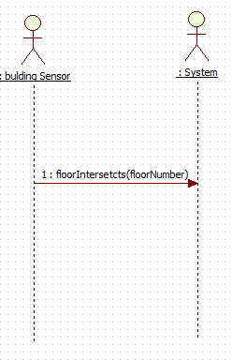
UC4: Floor Intersection
1. Elevator is arriving to the floor.
2. The building sensor system is activated. This in its turn activates Elevator sensor.
3. Elevator sensor sends floor Intersection signal to Elevator identifying the floor number.
4. If the intersected floor is destination, Engine stopped.
5. Elevator status is waiting until time Out is over or user invoked close door event.

Slide 9
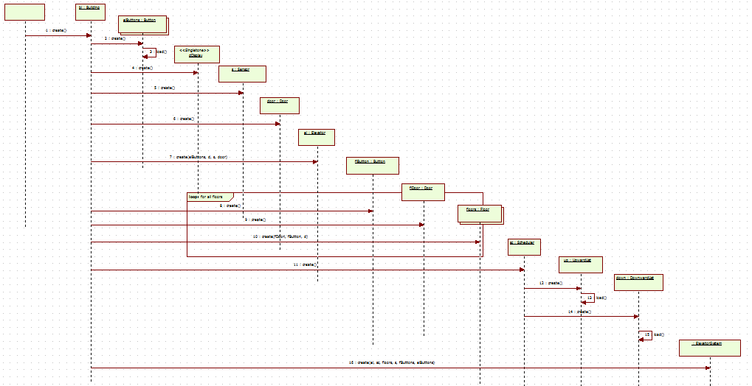
StartUp

Slide 10
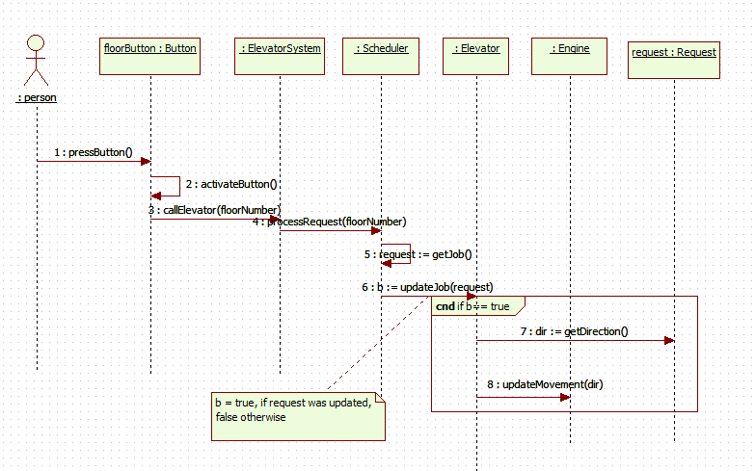
CallElevator

Slide 11
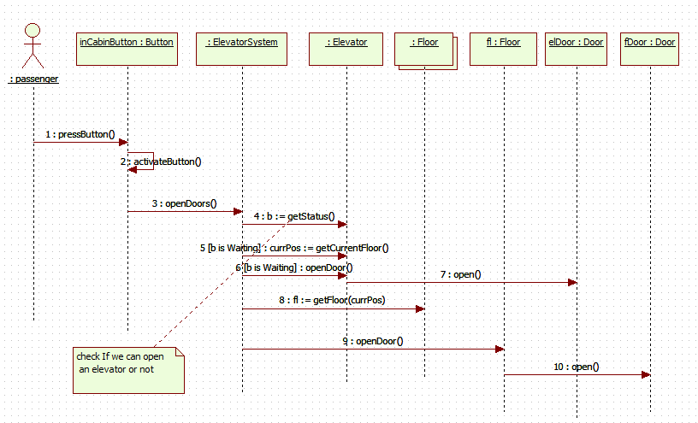
Open Door

Slide 12
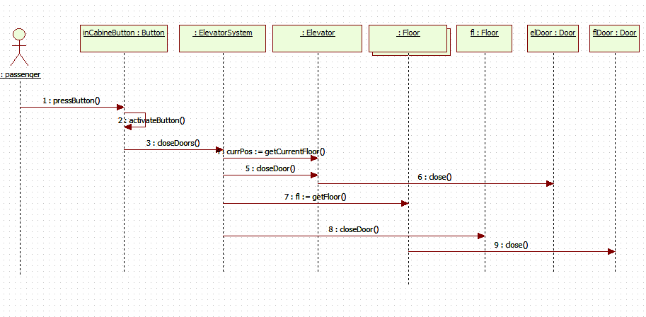
Close Door

Slide 13
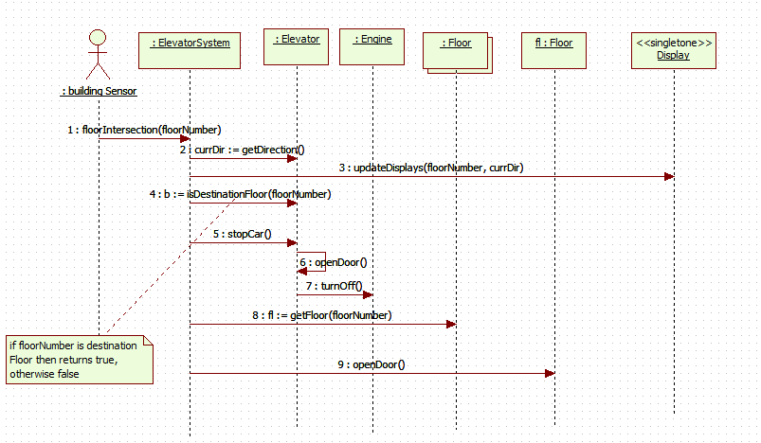
Elevator Intersection

Slide 14
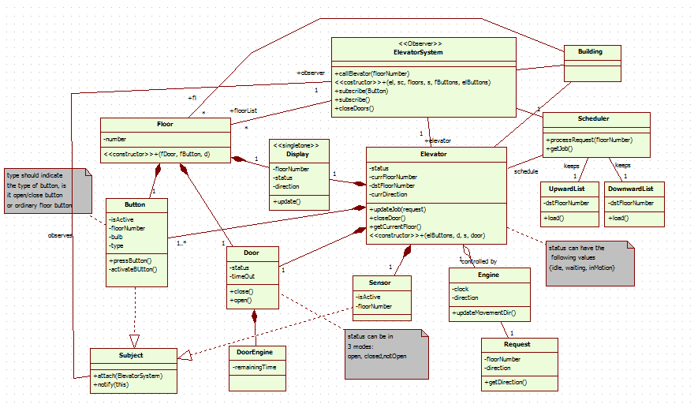
Class Diagram

Slide 15
Thank You

